Slide 1
How the New Rule Changes
– and Doesn’t Change -
the Process of Investigation

Slide 2
Session Agenda
Where we are: Context and Framework
A Shrinking Scope: What’s In and What’s Out
- Break -
Top Ten Things to Know about Investigations under the New Rule
- Break -
IV. Investigation Nuts & Bolts

Slide 3
TITLE IX
  No person in the United States shall, on the basis of sex, be excluded from participation in, be denied the benefits of, or be subjected to discrimination under any education program or activity receiving Federal financial assistance.

Slide 4
Title IX’s Purpose
Prohibitions or Limitations on Participation Based on Sex
Unequal Funding of Men’s and Women’s Athletics
Pregnancy Discrimination
Sexual Harassment
Sexual Assault
Stalking
Domestic/Dating Violence
Verbal/expressive

Slide 5
The 2011 and 2014 Guidance
Efficacy
Focused attention and resources on the problem of sexual harassment
Overreach
Raised concerns that Respondents were being treated unfairly
It did not change the law.

Slide 6

The Final Rule is More than Guidance
The Title IX process is now legally mandated.
A Final Rule is not easily made or unmade.
Final Rule released: May 6, 2020
Compliance deadline: August 14, 2020

Slide 7
Overarching Goals of Final Rule
Narrow the scope of incidents that fall within the law
Title IX under
Obama-era
Guidance
Title IX under
Final Rule
Recalibrate the procedural balance between complainants and respondents

Slide 8
Title IX Coordinator
Policies
Training
Grievance Initiation
Support Services
Investigation
Adjudication
or
Informal Resolution
Analysis & Prevention
Extensive
None
Moderate
Extensive
Extensive
Moderate
Minor

Slide 9

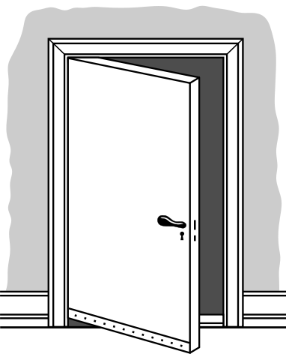
Grievance initiation: A shrinking scope

Slide 10
Mandatory Response to a Report
Document
The Title IX Coordinator must promptly:
Contact the Complainant to discuss the availability of supportive measures,
Inform the Complainant that supportive measures are available whether they file a complaint or not,
Consider the Complainant’s wishes with respect to supportive measures, and
Explain the process for filing a formal complaint, the grievance process, and any informal resolution options.

Slide 11
If a Formal complaint is filed...
Time for a dismissal analysis
1. Who is the complainant?
  Was the complainant “a person in the United States?”
2. Where did the incident(s) take place?
3. What type of conduct occurred?
3 ½
Threshold
Questions

Slide 12
Two buckets
Title IX Sexual Harassment
Forms of harassment on the basis of sex that fall within the Final Rule’s definition of sexual harassment and jurisdictional scope. These cases must be handled in accordance with the Final Rule.
Other Sexual Harassment
Forms of harassment on the basis of sex that do not fall within the Final Rule’s definition of sexual harassment and/or jurisdictional scope.
(TIXSH)
TIXSH
(OSH)
OSH
Schools may decide for themselves how to handle OSH cases.

Slide 13
Threshold Question 1:
Was the complaint in the us at the time of the incident?
  No person in the United States shall, on the basis of sex, be excluded from participation in, be denied the benefits of, or be subjected to discrimination under any education program or activity receiving Federal financial assistance.

Slide 14
Mandatory dismissal
If the complainant was not “a person in the United States” at the time of the incident, the incident is not Title IX Sexual Harassment (TIXSH), and the school must dismiss the formal complaint as a Title IX matter.

Slide 15
WHO (person in the US)
Dismissal analysis

Slide 16
THRESHOLD QUESTION 2:
WHERE DIDTHE INCIDENT(S) TAKE PLACE?
Anywhere if impact results
Programs/ Activities
On Campus
Obama Era

Slide 17
THRESHOLD QUESTION 2:
WHERE DIDTHE INCIDENT(S) TAKE PLACE?
New Rule
Programs/ Activities
On Campus

Slide 18
Substantial Control over Context (Where)
Locations
Residence halls
Classrooms
Campus grounds
Greek houses
Events
School sporting events
School festivals
Circumstances
Athletics
Extracurriculars Clinics/Internships
Everything Else
Private off-campus housing
Off-campus bars or restaurants
Off-campus parties
Personal travel
Your education programs & activities

Slide 19

Where do e-interactions take place?
Physical Location of Parties
Hardware
Platform/Network
Event/Activity

Slide 20
E-Interactions pop quiz
Working from home on a school-issued laptop, a professor sends pornography to colleague
Students are listening to a Zoom lecture from home on personal devices. One sends another a harassing note in the private chat.
A student uses an iPhone to send nude photos of their ex to three friends. One of the friends is on campus.
* Hardware * Platform/Network
* Platform/Network * Event/Activity
* Physical location

Slide 21
Did this e-interaction take place in our education program or activity?
One student keeps texting another explicit messages despite being asked to stop.
Physical Location of Parties?
Both off campus
Hardware?
Both using personal cell phones
Platform/Network?
Both on cellular or home networks
Event/Activity?
Always happens late at night

Slide 22
Mandatory dismissal
If the incident did not take place within the school’s program or activity, the incident is not Title IX Sexual Harassment (TIXSH), and the school must dismiss the formal complaint as a Title IX matter.

Slide 23
WHO
(person in the US)
WHERE
(in school program)
Dismissal analysis

Slide 24
THRESHOLD QUESTION 3:
WHAT TYPE OF CONDUCT OCCURRED?
Sexual Assault
Dating and Domestic Violence
Stalking
A school employee conditioning the provision of an aid, benefit, or service on participation in unwelcome sexual conduct
---------------------------------------------
Unwelcome conduct (Expressive: verbal, written, body language)*
* determined by a reasonable person to be so severe, pervasive, and objectively offensive that it effectively denies a person equal access to the school’s education program or activity
Clery Act, VAWA Act Definitions
Quid Pro Quo

Slide 25
What constitutes sexual harassment?
“Unwelcome conduct of a sexual nature,” that includes “unwelcome sexual advances, requests for sexual favors, and other verbal, nonverbal, or physical conduct of a sexual nature.”
“Unwelcome conduct determined by a reasonable person to be so severe, pervasive, and objectively offensive that it effectively denies a person equal access to the school’s education program or activity”

Slide 26
Sending a highly explicit pornographic
image on a single occasion (not pervasive)
Sending swimsuit pictures on a daily basis (not severe)
New Definition of Sexual Harassment
Sending highly explicit pornographic images on a daily basis

Slide 27
Mandatory dismissal
The school must dismiss the formal complaint with regard to that conduct* for purposes of sexual harassment under Title IX.
* Complaint could be dismissed in part

Slide 28
WHO
(person in the US)
WHERE
(in school program)
WHAT
(clery, qpq,level 4)
Dismissal analysis
Investigation

Slide 29
Mandatory dismissal pop quiz
Complainant sexually assaulted by fellow student at his off-campus apartment.
Complainant propositioned by professor and offered higher grade at University’s study abroad program in Luxembourg
Student in clinical nursing program sexually harassed by patient at hospital
Student pushed to the ground on athletic field by angry boyfriend – just one occasion
Professor tells student that he is her type and she could give him the climax of his life
DISMISS
DISMISS
KEEP
KEEP
DISMISS

Slide 30
Top Ten Things to Know
about Investigations
under the New Rule

Slide 31
The Top Ten
1. Impartiality is important.
2. The investigator does not adjudicate.
  Parties are entitled to notice of all interviews.
  An advisor may be present at all meetings.
  The school has the burden of collecting evidence.
  Parties may freely gather and present evidence.
  Parties may freely discuss the allegations.
  Parties may inspect and review evidence.
  The report summarizes relevant evidence.
  Investigators may be questioned.

Slide 32
The Importance of Impartiality
Conflict of Interest
Bias
Pre-judgment
Training

Slide 33
Conflict of Interest
Could the outcome of this case impact me one way or another? (i.e. Do I have a dog in this fight?)
Relationship – party or witness
Reputation
Interest – financial, programmatic

Slide 34
Bias
“Believe Women.”
“When you’ve taught as long as I have, you know students lie.”
“Athletes have been given a sense of entitlement to do whatever they want.”
“Typical fraternity house atmosphere.”

Slide 35
Pre-judgment
Classic “two drunk kids” case.
“I had one almost exactly like this last year.”
Respondent presumed not responsible.
Be open to the possibility of alternative explanations (The Warehouse Door)

Slide 36
No “single investigator” model
Fair
Investigation
Fair
Adjudication
Fair Determination

Slide 37
Minimize Determinationst
Raul showed us texts and time-stamped photos that were consistent with his account of what happened. Paul gave a different timeline every time we spoke to him and said he had accidentally deleted all his texts. Raul’s account is more credible.
------------------------------------
The parties most likely had sex prior to going out for pizza. Connor was confident that they had sex prior to leaving the apartment. Julia wasn’t sure about that, but said her memory wasn’t very clear.

Slide 38
Adequate Notice
Initial Notice: Identity of parties involved
Alleged conduct at issue
Date and location
Meeting Notices: Date, time location
Participants
Purpose
I
In writing. Sufficient time to prepare to participate. Duty to supplement initial notice.

Slide 39
An Advisor May Be Present
You Must… | You May…
Allow each party to use their advisor of choice | Limit each party to one advisor
Allow the advisor to be present at all meetings, interviews, etc. | Place limits on the advisor’s role
Have the advisors conduct the live questioning at the hearing | Require that questions be relevant, respectful, and non-abusive
Ensure that each party has an advisor at the hearing | Provide an advisor of your choice
* Advisor of student’s choice

Slide 40
Slide about advisor limits
Add from template of advisor instructions

Slide 41
The School has the burden of collecting evidence.
Party: I guess there must be a police report, because I called the police that night.
Investigator: Great. If you can get a copy, we will definitely include it in the report.
Investigator: Great. We would like to get that. Do you remember the name of the officer?

Slide 42
The School has the burden of collecting evidence, but...
The school (including you the investigator) cannot
Access
Consider
Disclose
Or otherwise use
a party’s records that are made by a physician, psychiatrist, psychologist, etc. without voluntary written consent to do so for the grievance process.

Slide 43
Parties may freely gather and present evidence.
Party: Here – I asked all my friends who were there to write down what they saw and sign the statement.
Investigator: We need to be the ones to collect evidence. If you think someone is a witness, just give us his or her name, and we’ll take it from there.
Investigator: Thanks. Do you have phone numbers for these people?

Slide 44
Parties may freely discuss the allegations.
Party: I’m going to get together with my friend to compare our memories of that night.
Investigator: Don’t do that. It could interfere with your independent recollections. Don’t talk to your friend about the investigation at all.
Investigator: You’re free to do that if you choose. Just be aware that you and your friend could each be asked if you discussed your testimony in advance.

Slide 45
Parties may review the evidence.
Ten days to submit a written response
Investigators
Gather
Relevant
Directly Related
Not Directly Related
Parties Review
Relevant
Directly Related
Investigators Write
Summary of all relevant evidence
Prior to finalizing the investigative report

Slide 46
The Investigative Report
The report fairly summarizes the relevant evidence.
At least 10 days prior to the hearing, send the report to each party (and advisor)
** Check with coordinator re uniquely sensitive information

Slide 47
Investigators May Be Questioned
Hearings may be virtual, but they must be live, i.e. everyone can see and hear one another in real time.
Investigators must attend.
The decision maker(s) may ask questions of the investigators.
The parties’ advisors may ask questions of the investigators.

Slide 48
The complainant gave you a list of 10 possible witnesses. Why did you only interview 5 of them?
Did you check university security cameras for footage related to the incident?
How long did you spend interviewing the complainant and how long did you spend interviewing the respondent?
Why didn’t you include the parties’ texts of March 15 in the investigative report?
Why did you include the parties’ texts of March 15 in the investigative report?

Slide 49
Parties may review the evidence.
Ten days to submit a written response
Investigators
Gather
Relevant
Directly Related
Not Directly Related
Parties Review
Relevant
Directly Related
Investigators Write
Summary of all relevant evidence
Prior to finalizing the investigative report

Slide 50
Sorting Information
All Information Gathered
Not Directly Related
Directly Related
In the Review
Relevant
In the Review
In the Report

Slide 51
General Principles of Information Sorting
Intent of the rule is to provide the parties with access to information. Philosophy:
Increased Access = Increased Fairness
Bad outcome 1: Party is surprised at hearing by information not shared with them previously.
Bad outcome 2: Party never had a chance to see information that could have impacted the outcome of the case if they had only had a chance to explain its relevance.

Slide 52
Avoiding Bad Outcomes
Be as thorough as possible in the investigation and interviews.
Ask “exhausting” questions: Is there anything else? Have you looked carefully on your phone for additional information? Please notify us right away if anything else comes to you.
Error on the side of including information in the review of “directly related” material.

Slide 53
What do those terms mean? Good question…
Relevant
Evidence, whether inculpatory or exculpatory, on which the school will rely in reaching a determination regarding responsibility
Information or evidence that has a clear relationship to the allegations at issue but is not necessary to reach a determination regarding responsibility
Information or evidence that has no readily apparent relationship to the allegations at issue
Directly Related
Not Directly Related

Slide 54

Rape Shield Rules
Questions and evidence about the complainant’s sexual predisposition or prior sexual behavior are not relevant
Offered to prove that someone other than respondent committed the conduct
2. Concern specific incidents of prior sexual behavior with respondent and offered to prove consent
Questions/evidence about respondent’s sexual predisposition or prior sexual behavior may be relevant

Slide 55
The Investigation
Plan and Process

Slide 56

To Be a Successful Investigator…
  Focus on learning, refrain from assuming
  Active listening
  Assess credibility
  Search for corroboration
  Gather and organize the most robust set of facts
  Create reliable documentation

Slide 57
Typical Investigator Responsibilities
Frame/plan investigation
Gather evidence
Create report
Provide conclusions and/or recommendations on responsibility and/or sanctions (as applicable)
Provide subsequent testimony (as applicable)

Slide 58
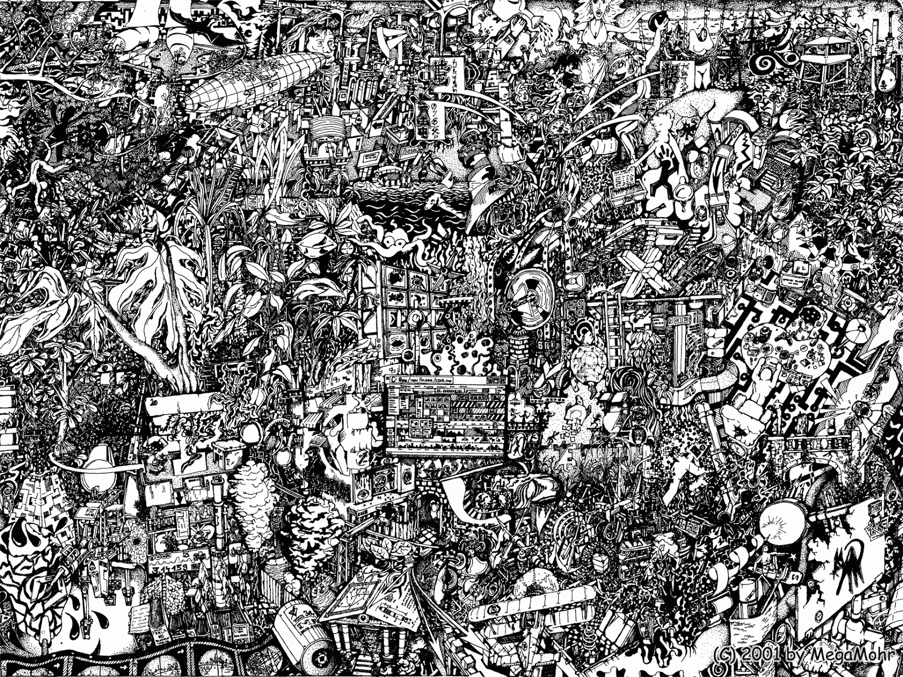
Clear list of policy violations at issue based on alleged conduct
Clear timeline of incident(s) with any areas of dispute or ambiguity noted
Clear narrative of events delineating undisputed and disputed facts
Clear description of corroborating evidence or lack thereof
In other words…
Making order
out of chaos
and painting as clear a picture as possible

Slide 59
The 3 Stages of Investigation
Stage 1: Orienting
Stage 2: Gathering
Stage 3:
Organizing
Create report
• Refresh on P&P/values
• Draft investigation plan
• Interview
• Collect

Slide 60
Stage 1: Orienting
• Refresh on P&P/values
• Draft investigation plan
➔ Re-sensitize yourself to the issues of objectivity, trauma, etc.
➔ Review key aspects of P&P such as definitions
** get your investigator hat on**

Slide 61

Stage 1: Orienting
Define (Initial) Scope
Single or multiple incidents?
Single or multiple perpetrators?
Single or multiple forms of misconduct??
Post-assault harassment or retaliatory conduct?
Relevant prohibited conduct and definitions?

Slide 62

Critical Importance of
Prohibited Conduct Definitions
Policy violation determination central to investigation and adjudication
Relevant definitions must be studied and referred to often and must guide investigator/adjudicator actions

Slide 63
1. Start With the Official Definition
“Offensive Sexual Touching” is the intentional sexual touching, without consent, of another person’s intimate parts (including, but not limited to, genitalia, groin, breast, buttocks, or mouth), whether clothed or unclothed, or the intentional sexual touching, without consent, of another person with one’s intimate parts, or for purposes of sexual gratification, using force to cause another person to touch his/her own or another person’s intimate parts. Offensive Sexual Touching may be committed using one’s own body, a part thereof, or an object.
Stage 1: Orienting

Slide 64
2. Identify the Elements
1. ◻ Intentional touching
2. ◻ Without consent
3. ◻ Of another person’s intimate parts
(intimate part: )
or
◻ With respondent’s intimate parts
      (intimate part: )
      or
      3. ◻ For purposes of sexual gratification
      ◻ Using force
      ◻ To cause another person to touch their own or another person’s intimate parts
      (intimate part: )

Slide 65
Determine Whether Each
Required Element is Present
1. ◻ Intentional touching
2. ☑ Without consent
3. ☑ Of another person’s intimate parts
(intimate part: breasts )
or
◻ With respondent’s intimate parts
      (intimate part: )
      or
      3. ◻ For purposes of sexual gratification
      ◻ Using force
      ◻ To cause another person to touch their own or another person’s intimate parts
      (intimate part: )

Slide 66
Stage 1: Orienting
Investigation Timeline
Establish a preliminary timeline for the investigation
  Interviewing parties
  Interviewing witnesses
  Drafting statements
  Verifying statements
  Gathering/obtaining documentation
  Drafting a report

Slide 67
Stage 1: Orienting
Investigation Timeline L Log
    Log the receipt of information, evidence, and other materials as it is obtained in the course of the investigation
    Log unsuccessful searches for evidence
    Log delays
    Log communications with witnesses
    Log procedural communications with administrators, attorneys, etc.

Slide 68
Stage 2: Gathering

Slide 69

The Importance of Corroboration
Corroboration = confirmation from another source
What information/source could confirm or rebut each aspect of a party’s statement?

Slide 70
Stage 2: Gathering
Police reports
Campus security reports
Hospital/medical reports
Security video tapes
Social media posts
University records
Building entry/exit logs
Photographs & videos
Diary/journal entries
Character evidence
Texts, voicemails, & emails

Slide 71

Stage 2: Gathering
Interviewing

Slide 72

Stage 2: Gathering
Interviewing Basics:
Pre-Interview
Keep private (not just content, but occurrence)
Hold in-person
Allow presence of advisor
Consider a partner if possible
Draft an outline

Slide 73
Stage 2: Gathering
Interviewing Basics: Setting the Tone
Develop rapport to put the individual at ease
Be sensitive to fears, embarrassment & confusion
Be objective, straightforward and matter-of-fact
Explain your role – neutral, no conclusions have been reached
Discuss confidentiality/privacy/information security
Remind of prohibition against retaliation
Remind of information regarding resources and support

Slide 74
Interviewing the Parties

Slide 75
Issue Spotting: The Complainant’s Monologue
Option to withdraw complaint in writing
Advisor options
Mediation
Adjudication/questioning
Expulsion for lying in investigation
Confidentiality
  w/r/t Respondent
  w/r/t parents
  w/r/t others
Retaliation

Slide 76
Issue Spotting: The Respondent’s Monologue
Participation – mandatory or voluntary
Requested delay
Confidentiality
  Coach
  Parents
Protection of sibling
Involvement of friends
Retention of/need for a lawyer
Potential threats of retaliation

Slide 77
Interviewing Best Practices
Considerations
  Partner/Assistant
  Recording
  Write-up of interview immediately afterwards
  Reviewing interview write-up with interviewee
Accuracy is key in your notes
  Demarcate exact quotes
  Do not include analysis/conclusions
  Note areas of agreement/disagreement
Remember
  Potentially for an external audience
Stage 2: Gathering

Slide 78

The Interview Funnel
Broad collection of data
⇩
Careful clarification of answers
=
Information you need

Slide 79
Stage 2: Gathering
The Interview
Allow time for the interview to wander
Don’t take charge immediately. Allow the witness to narrate without interruption. Clarify what you need to when their narration is complete. If the flow is interrupted, use open-ended questions to get it restarted.
Use specific, precise, closed questions to get a precise answer when one is needed.
Do not be accusatory or judgmental. Minimize negative reaction cues.

Slide 80

Stage 2: Gathering
Useful Open Questions
Would you be willing to tell me more about…?
How did you feel about…?
What did you do after…?
What happened then?
What did you mean when you said…?
Can you tell me more about that?
How did you become involved in…?
What is your understanding of…?

Slide 81
Stage 2: Gathering
How to Ask Questions
Avoid: Compound Questions
  Legal Terms
Examples:
Did you give a clear answer or did you just leave it open ended?
Have you ever been through an adversarial adjudication process before?

Slide 82
Stage 2: Gathering
How to Ask Questions
Do: Ask how interviewee is defining words.
Push beyond euphemisms.
Exhaust, i.e. “anything else?”
Examples:
You said he acted “crazy.” In what sense?
When you said she “wanted to get with you,” what did you mean by that?
Is there anything we haven’t covered about the time in the park that you think would be helpful for me to know?

Slide 83

Stage 2: Gathering
How Not to Ask Questions
Do not: Editorialize
Comment
Examples:
Ugh – you must have been disgusted.
This is so typical of Kappa Alphas.
Something similar happened to me when I was about your age…

Slide 84
Stage 2: Gathering
How to Ask Questions
Do: Think about the elements of definitions.
Ask key questions directly.
Examples:
Did you intentionally touch her breasts?
How many text messages did you send?
What signals did you get which indicated your conduct was welcomed?

Slide 85
Stage 2: Gathering
Helpful Questions
to Include
Who else should we talk to?
Have you spoken/texted with anyone about this or posted anything about this online?
How have you been affected by this?
How did you communicate what you wanted to responding party?
How did you know your actions were ok with the reporting party?
What motive would others have to accuse/lie?

Slide 86
Key Info/Reminders
At the beginning of EVERY interview:
  Brief explanation of investigatory process/purpose
  Objective and unbiased
  Collecting information; not making decision
  Explain that information will be shared
At the end of EVERY interview:
  Ask for documents
  “Is there anything else you want me to know?”
  Invite follow-up
  No retaliation (against you/by you)
Stage 2: Gathering

Slide 87
Assessing Credibility
General demeanor
Opportunity/capacity to observe event
Consistency with other evidence (including prior statements)
Willingness to lie/be truthful about other things
Stake in the outcome/motive to lie
Plausibility/Improbability of account
Specificity v. vagueness
Willingness to share texts, etc.
Corroborating evidence
Effects of trauma
Stage 2: Gathering

Slide 88
Credibility Determinations: Inconsistencies
Individual is inconsistent in own report
  Trauma or fear?
  Lying?
  Ask!
Individual is inconsistent with other evidence
  Outlier?
  Coached testimony?
  Ask!
Stage 2: Gathering

Slide 89
Credibility Determinations: Motive
What is the relationship with each party and with other witnesses?
Consider:
  Witness with an axe to grind?
  Witness who wants to protect?
  Witness who loves the spotlight?
  Witness who doesn’t want to be involved?
  Witness who has a ideological bias?
Stage 2: Gathering

Slide 90
Post-Interview Tasks

Slide 91
Stage 3: Organizing
Create Report
Start with deep understanding of institution-specific report procedure, practices, and guidance
Don’t reinvent the wheel! (best of samples & templates)

Slide 92

Investigative Report Table of Contents
Executive Summary
Allegations/Response
(jurisdictional exclusions)
Applicable policies/definitions
Investigative Process
Statements and credibility context
Description of other evidence (attach) and how it corroborates or undercuts parties’ statements

Slide 93

Tips for Drafting
Go back to your investigation plan
Make use of timelines/other graphics
Remember what you are investigating –
the specific conduct prohibited by Title IX
Carefully review the elements of each definition – Make sure each one is addressed by the content of the report
Write for someone who knows NOTHING about the parties, the issues and the situation
Proofread – no typos, spelling errors, assumptions, unexplained jargon
Ultimately writing for a reader later in the process

Slide 94

Not in the Investigation Report
Legal jargon
References to legal consultation
Physical descriptions of the parties (unless directly relevant)
Personal opinions/value judgments
Conclusions that should be made by the adjudicators

Slide 95


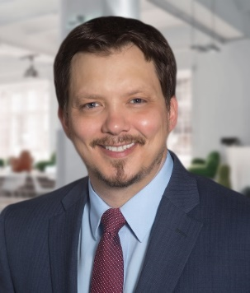

Your Parker Poe Title IX Team
Add La-Deidre Matthews
Add Maureen Zyglis
Sarah Ford
La-Deidre Matthews
Josh Whitlock
Maureen Zyglis
For Title IX assistance, contact Team Lead Josh Whitlock at joshwhitlock@parkerpoe.com or 704-335-6622

